Slide 1
Application of graph traversal for marathon training optimization
Saleh Alkhalifa
Gabriel Cuchacovich
Nile Naim

Slide 2

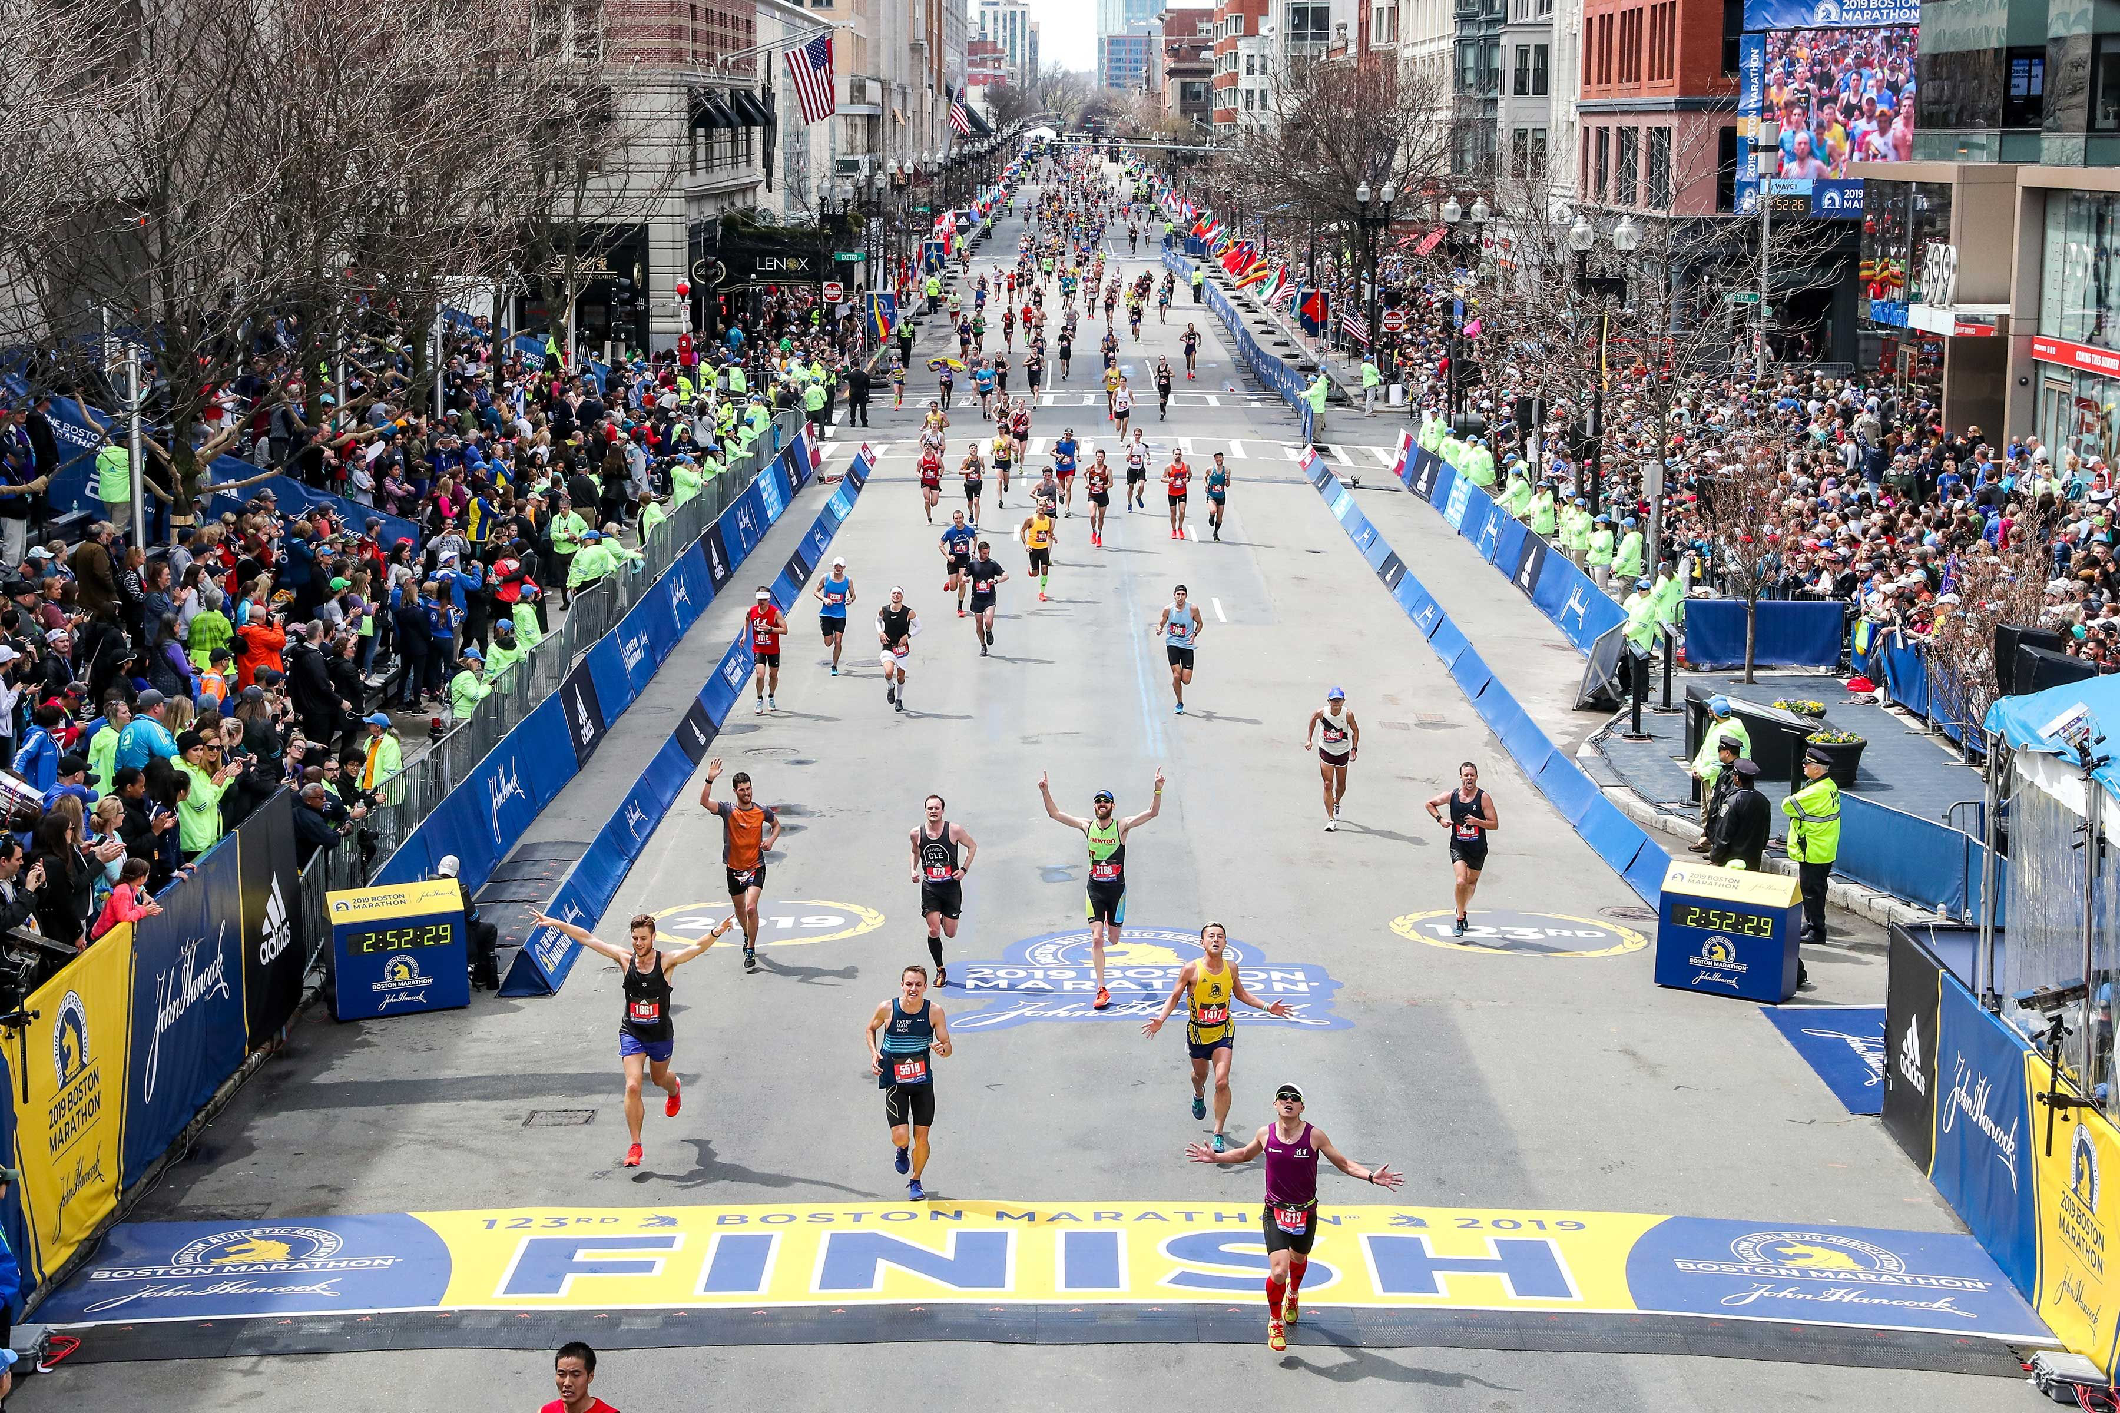
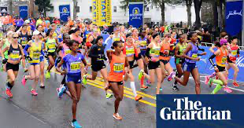
Background
One of the most famous annual events in the city of Boston is the Boston Marathon which was established in 1898, almost 125 years ago.
Being one of the top Marathons in the world, the ability to qualify is both rigorous and time consuming, requiring runners to have a great deal of practice.
While the Marathon welcomes runners from around the world, many of the participants come from dense cities such as Boston, making the ability to find optimal training paths quite challenging.

Slide 3
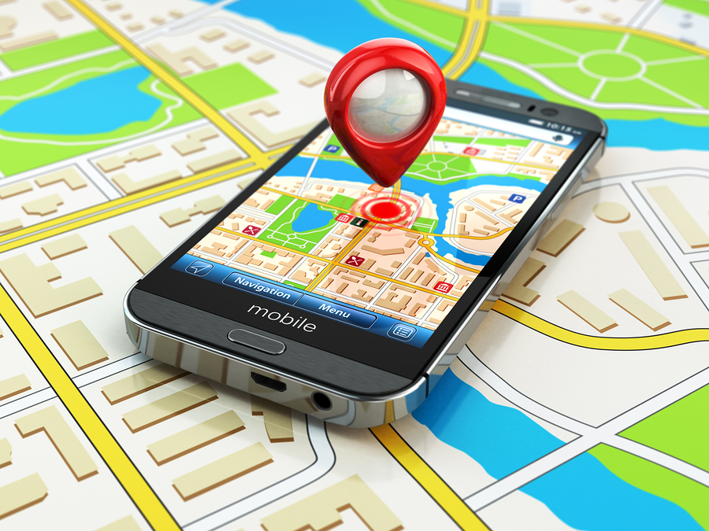
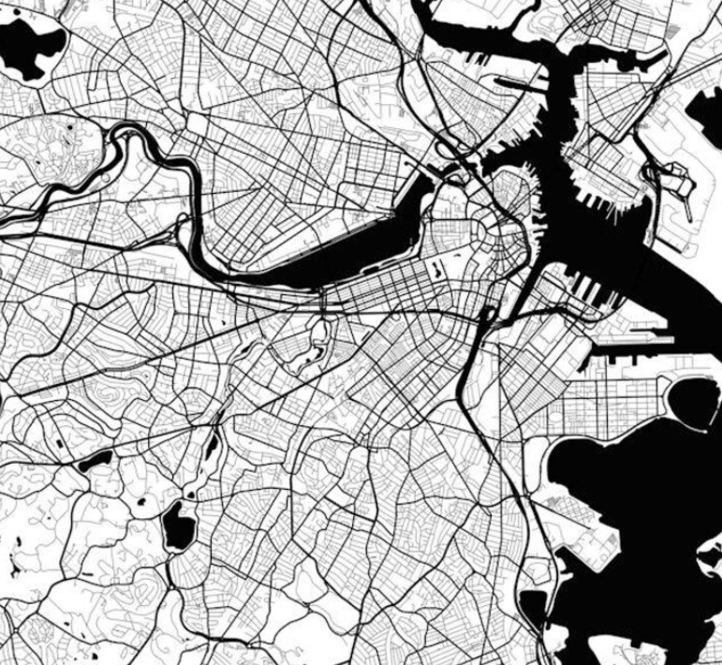
Problem Statement
There are many technologies and devices catered for cars allowing users to find optimal driving paths from a source to a destination
There does not exist many solutions that offer similar capabilities for runners, especially those in dense smaller cities such as Boston
Given the many algorithms we have covered this semester, we wanted to investigate the use of several for runners in the Boston area.

Slide 4
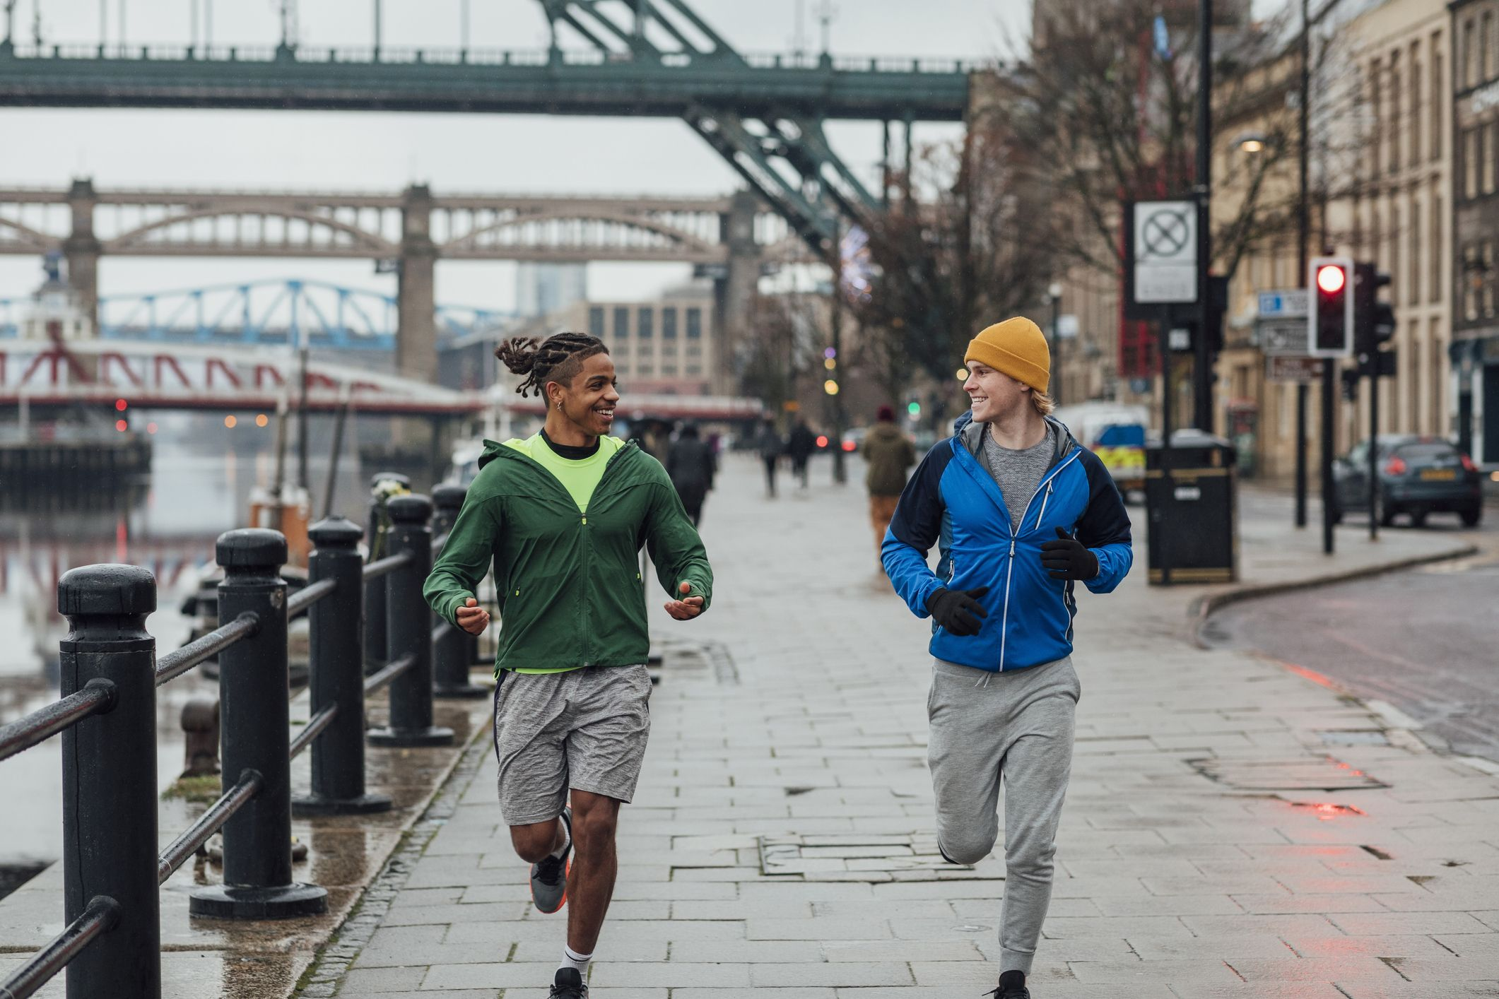
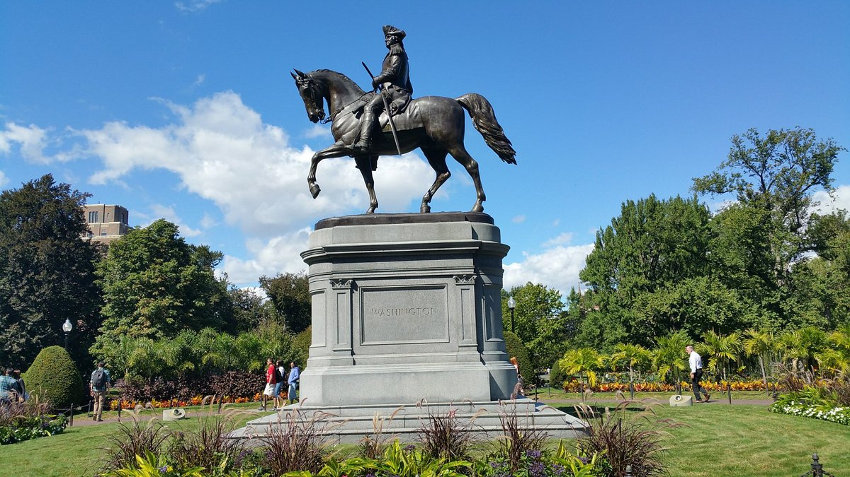
Methods
We hope to investigate three different use cases within our proof of concept (POC) application.
Methods:
Method 1:
Application of Dynamic Programming for Longest Limited Path Detection
Use Case: Users may want to find the longest paths in a small neighborhood to maximize distance, but limited to a specified amount.
Method 2:
Application of Shortest Path via Dijkstra’s Algorithm
Use Case: Users may want to visit certain sites in Boston to stay motivated on their run
Method 3:
Application of Interesting Site Prioritization via Travelling Salesman Algorithm
Use Case: Users can visit certain interesting sites in Boston to enhance the running experience
Method 4:
Application of Finding Routes with Specific Distances while Avoiding ‘Bad’ Roads
Use Case: Users can enhance their run by prioritizing paths of higher quality given a certain distance
Method 5:
Application of Generating a Path that Maximizes the Number of Interesting Sites to Visit
Use Case: Given a distance, users can enhance their experience by visiting interesting sites in Boston

Slide 5
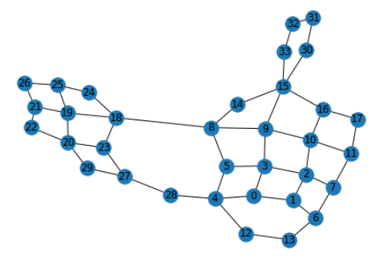
Graph Preparation
To demonstrate the feasibility of these algorithms, we prepared a proof of concept (POC) using a small neighborhood in Boston near Northeastern’s campus
We used the networkx library to draw and save the graph using the Python programming language
We drew our map using Google Earth, and traced the distance, measured in meters, using networkx
We then converted the dataset we obtained to an adjacency list (no weights), and an edge list (with weights).
Figure: A graphical representation of a small neighborhood in Boston near Northeastern’s campus.

Slide 6
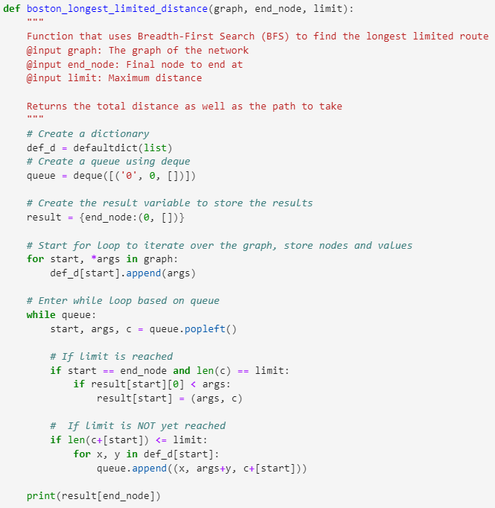
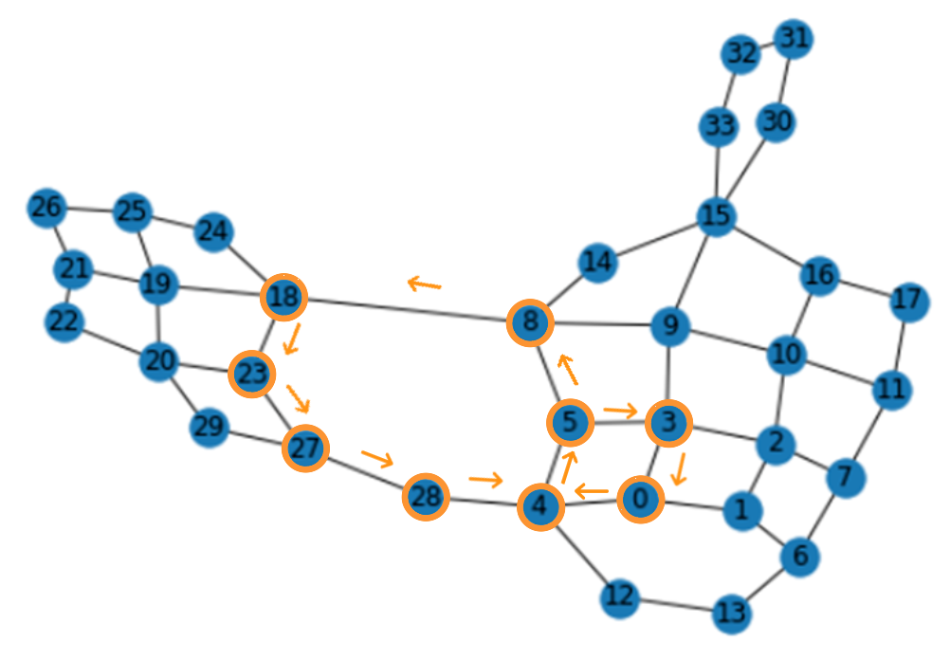
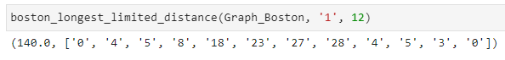
Method 1: Longest limited Path
Algorithm:
Instantiate a dictionary, queue, and result variables to manage the data (nodes and weights) and final values
Iterate over the graph to prepare the starting nodes and targets in a dictionary
Iterate over the queue to apply BFS
If the user specified limit is reached, end the program
If the limit is not reached, continue BFS algorithm
Original Map
Determined Path

Slide 7

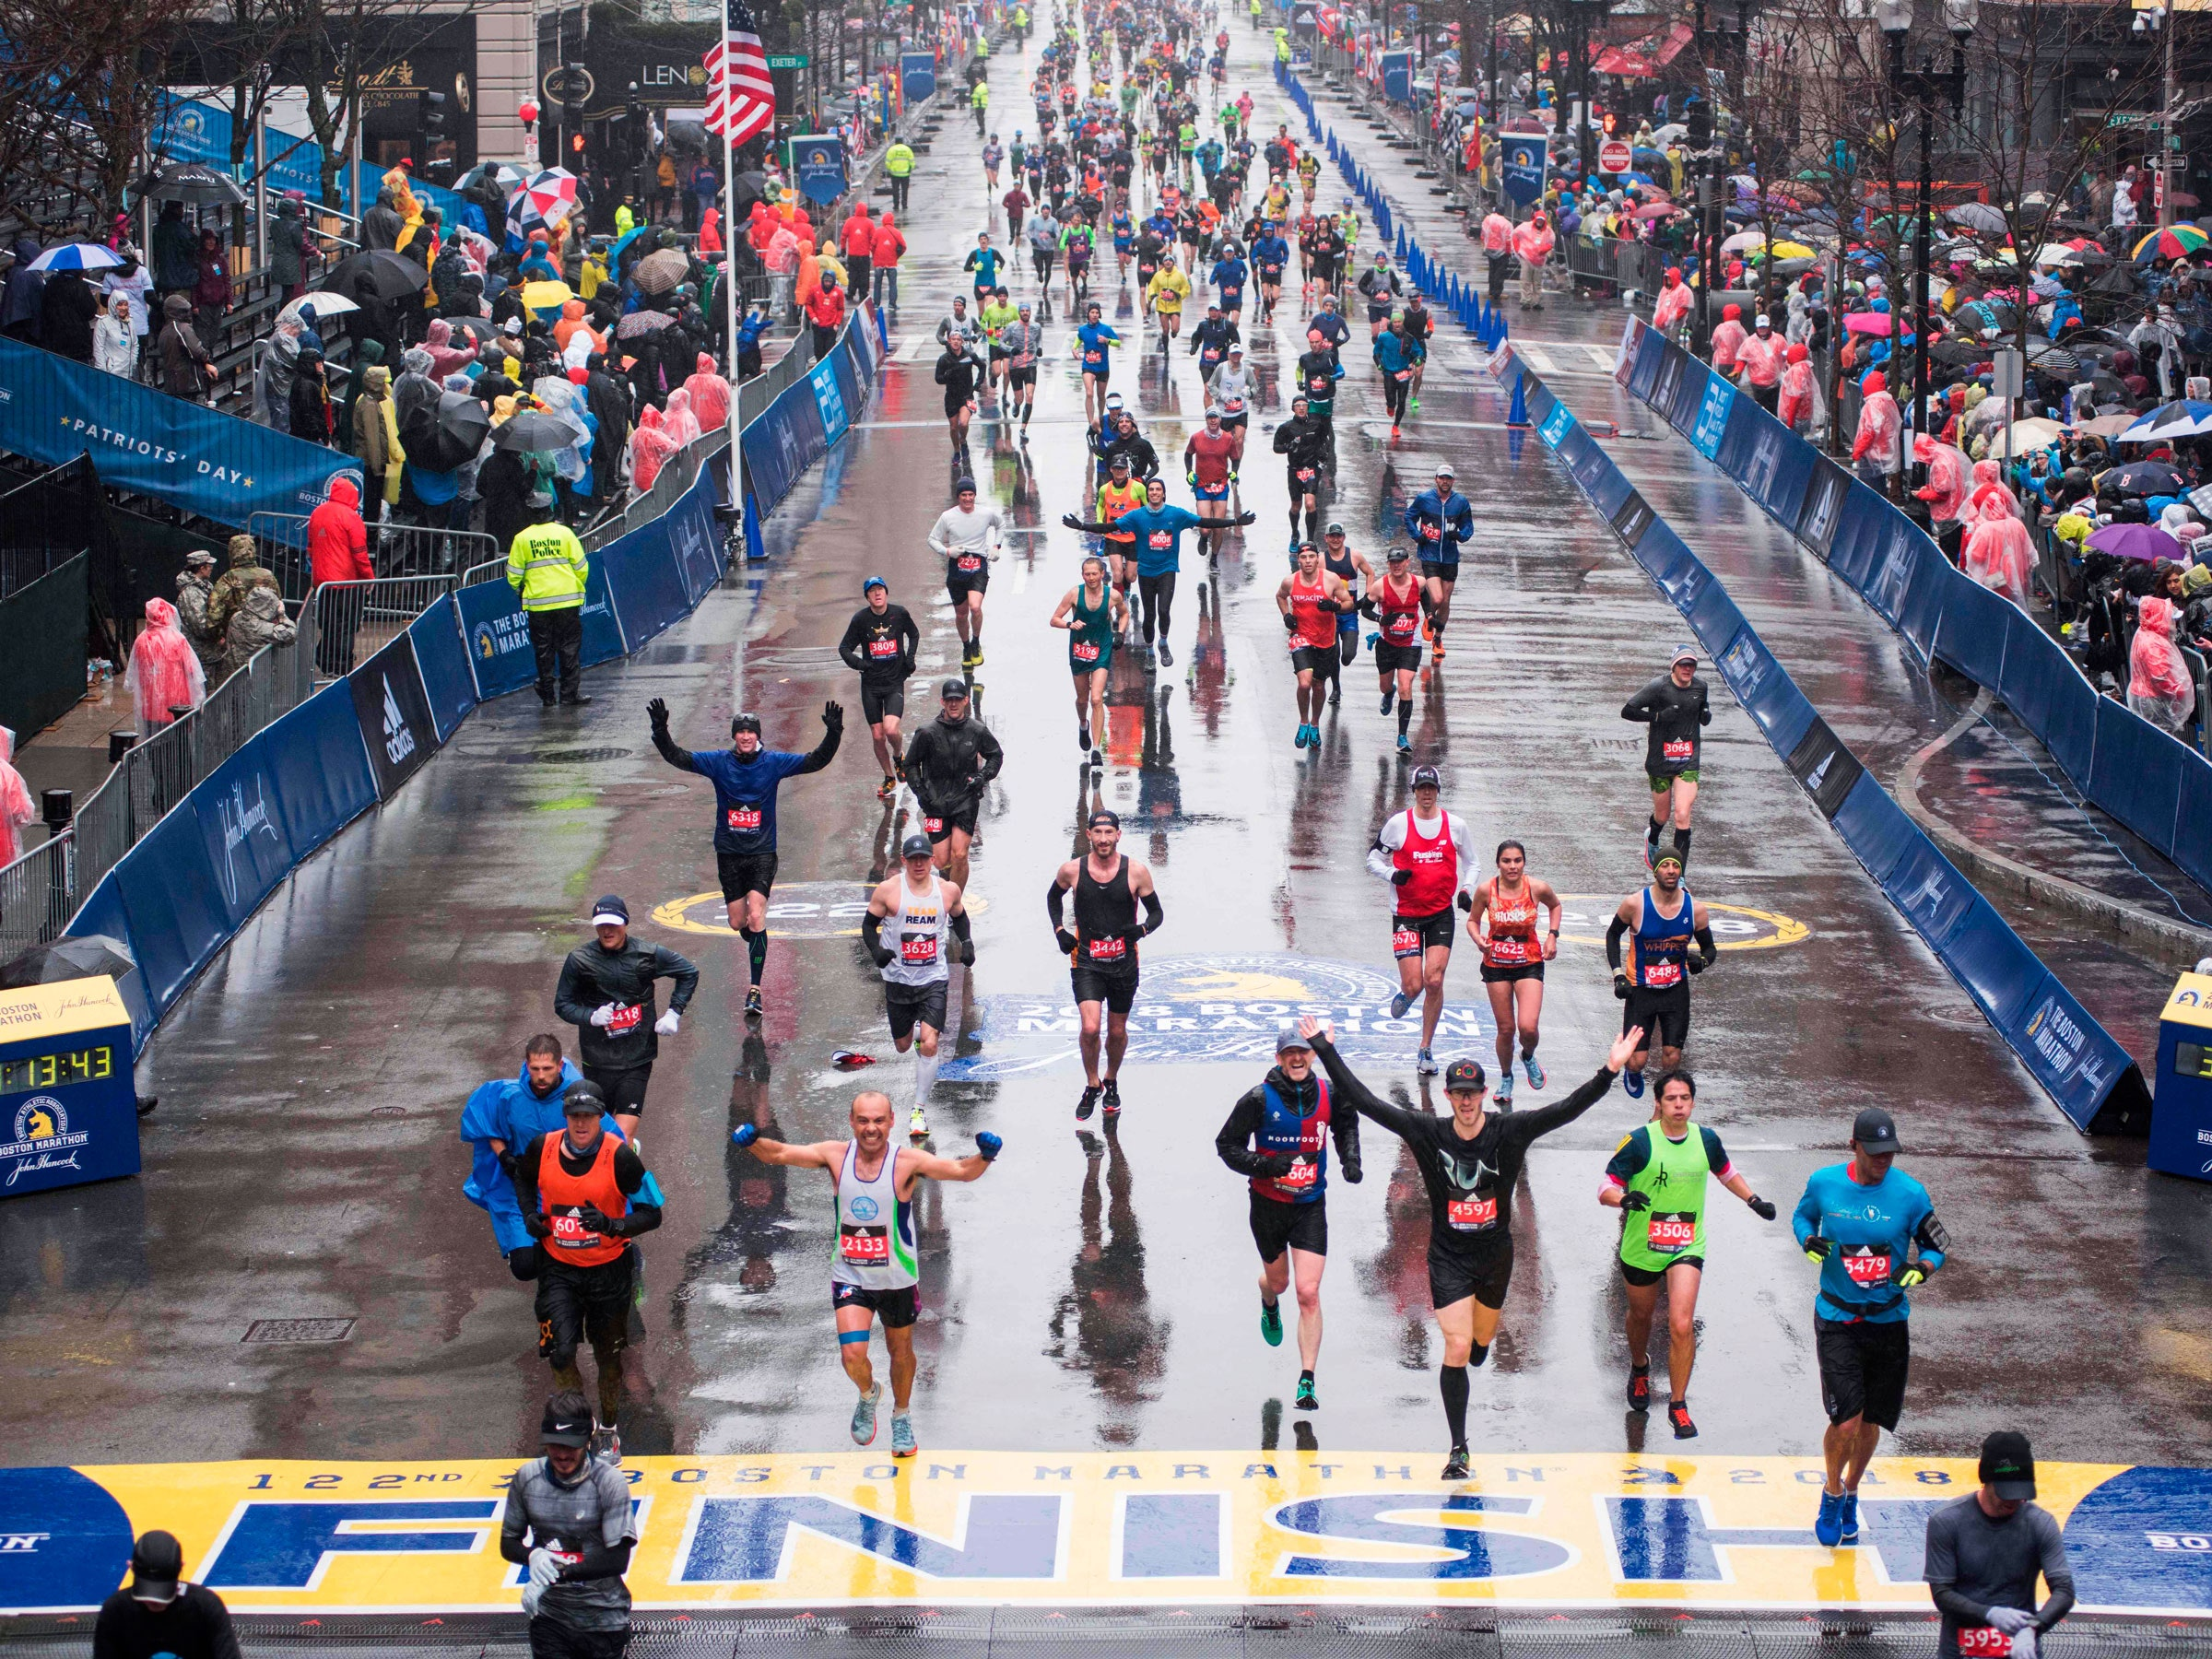
Method 1: Longest Limited Path Summary
The longest path problem is a well known area of research that involves finding a path of maximum length.
The longest path problem is NP-Hard, as opposed to the shortest path which can be solved in polynomial time.
Given that we want to allow the user to limit the length of the path, we used Breadth-First Search to allow this functionality.
The time complexity of BFS is O(|V| + |E|) in which V is a set of the nodes, and E is a set of the edges
Given our use case of focusing on smaller neighborhoods in the Boston area, within running distance, we do not anticipate users reaching higher values of nodes and edges.
In summary, we managed to develop an algorithm in Python based on BFS that allows the user to find a long path in a given neighborhood which can be limited based on the users preferences.

Slide 8
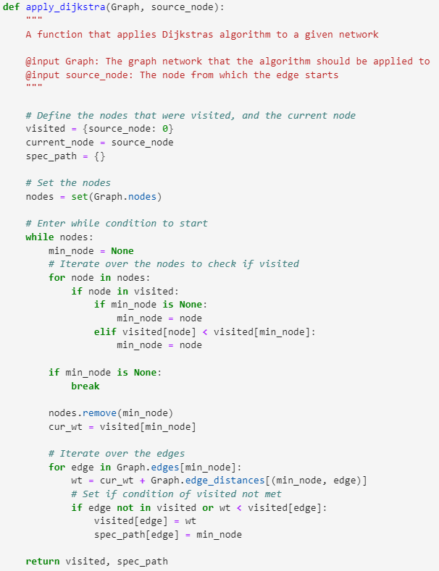
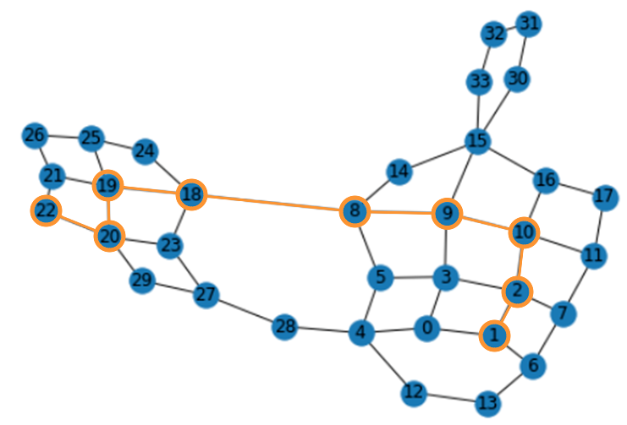
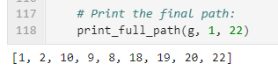
Method II: Dijkstra’s Shortest Path
Algorithm:
Mark the nodes unvisited and instantiate a new set for them
Set the initial distance from the source to the target as ‘infinite’
Calculate distances of neighbor nodes of the active node, sum distance with weights of distances from Graph
If calculated distance is smaller, update the distance and set the current node
Repeat until no nodes left and all accounted for
Original Map
Determined Path

Slide 9

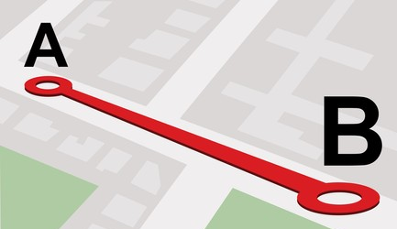
Method II: Dijkstra’s Shortest Path Summary
The shortest path problem has the objective of finding a path between two nodes in which the sum of weights between them is minimized relative to other paths
There are a number of different algorithms that have been developed to solve this problem: (1) Bellman-Ford, (2) Floyd-Warshall, and (3) Dijkstra’s.
For the purposes of this POC, we focused on Dijkstra’s algorithm.
In our previous method, we supported our long distance runners by finding the longest path. In this method, we support our short distance runners, or perhaps our lazy runners (such as myself), by finding the shortest distance between two nodes
In this algorithm, the time complexity as the result of each edge is O(|E|), and the complexity of each vertex is O(|V|).
Given our implementation, we reached a time complexity of O(|E| + |V|).
A future improvement could be to use a priority queue, in order to reach a time complexity of O(|E| + |V| log |V|)

Slide 10
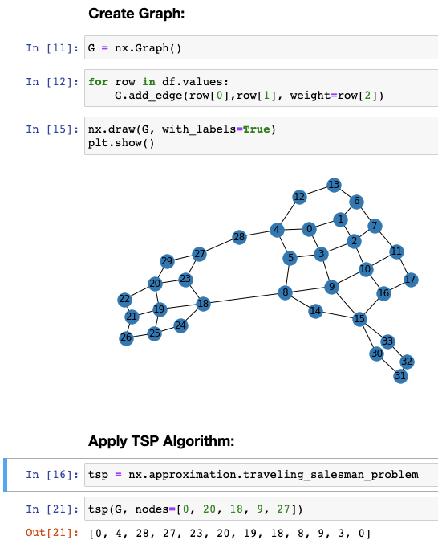
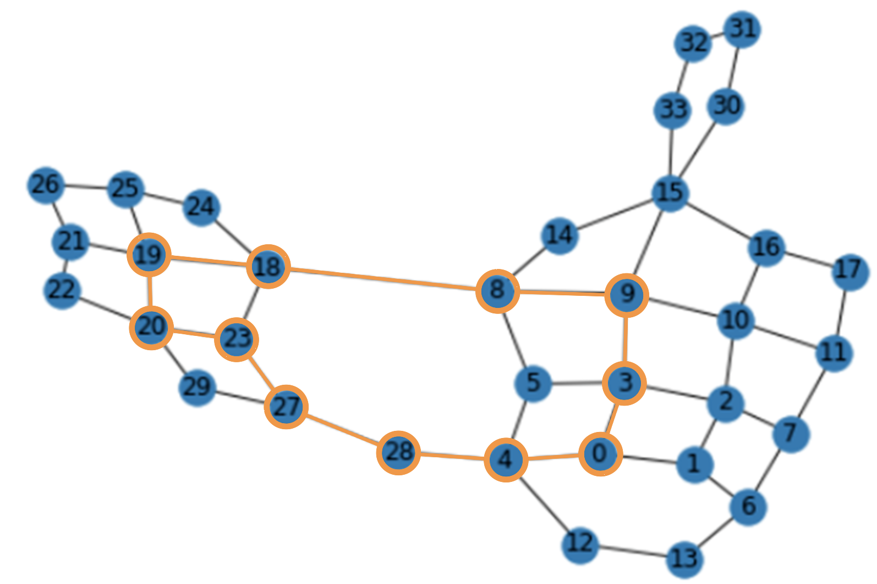
Method III: Traveling Salesman Problem
Algorithm:
We begin by instantiating a few variables to hold data
First, a list that will hold the indices of the nodes of interest
Second, a space to store the results which contains the nodes
Next, we traverse the adjacency matrix used to store the data
For every node, if the cost reach it is less than the current, update the current cost
Finally, we generate the minimum path cycle and return the min cost
Original Map
Determined Path

Slide 11
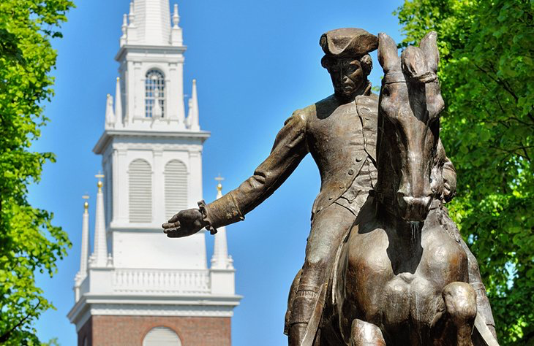
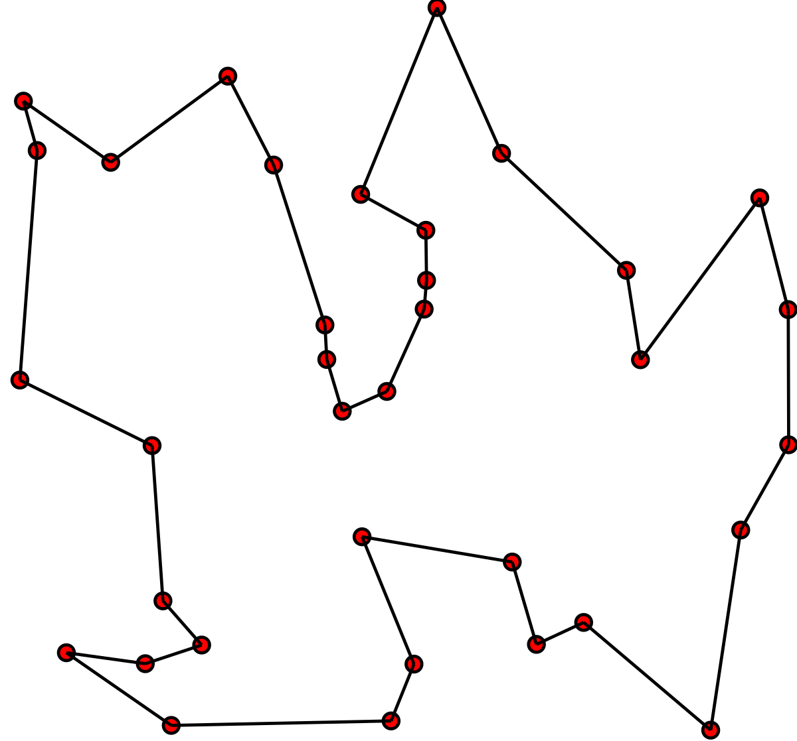
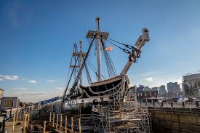
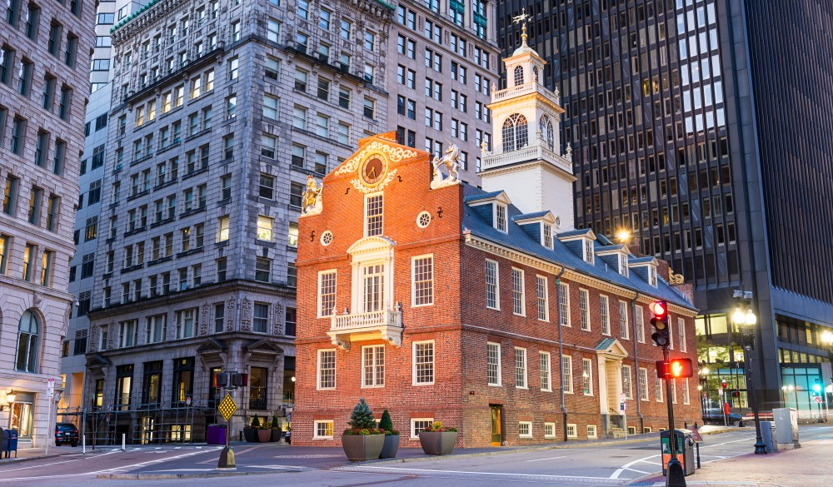

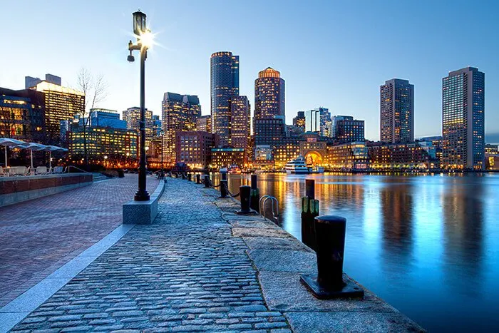
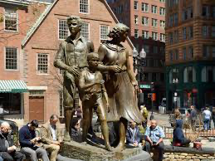
Method III: Traveling Salesman Summary
The travelling salesman problem is a well know and well studied problem in the field of CS.
In this project, our objective was to implement a greedy approach to solve this issue as a means of providing runners the ability to target certain locations within the Boston area to increase the quality and experience of their run.
Using the Networkx library, we investigated the use of the travelling salesman problem implementation to solve this
We specifically focused on the greedy implementation of this for the scope of this project
Given the methodology of this algorithm, we can see that the model achieves:
Time Complexity: O(N²log(n))
Space Complexity: O(N)

Slide 12
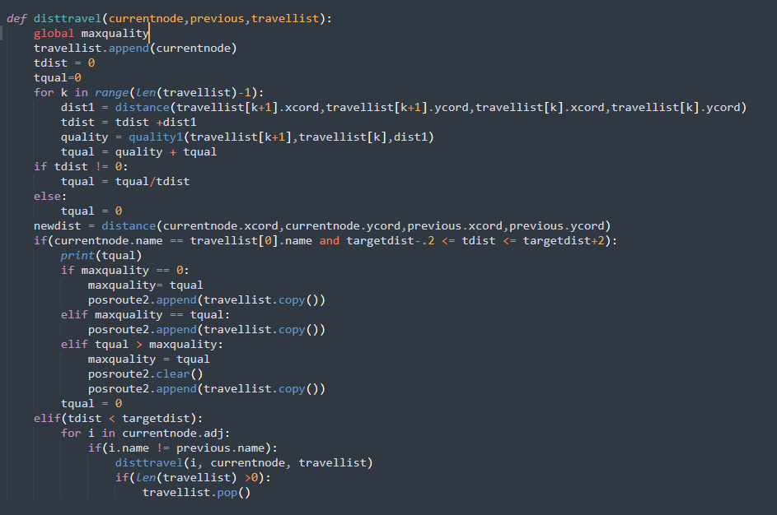
Method IV: Finding the best route for a set distance
Algorithm:
We apply another weight to a path which would represent the “quality” of the road.
Road conditions would negatively affect the quality score of a path
to quantify the quality of a path, each path’s edge is multiplied by the quality score and then divided by the total distance of the path giving a value between 0 and 1
Traversing the possible nodes is designed like depth first search.

Slide 13
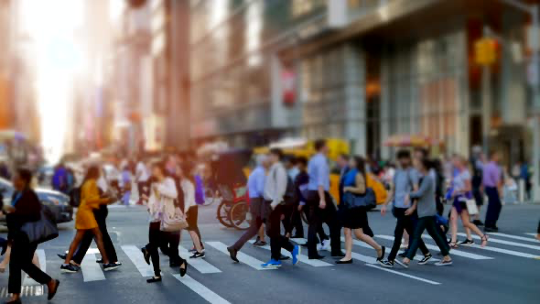
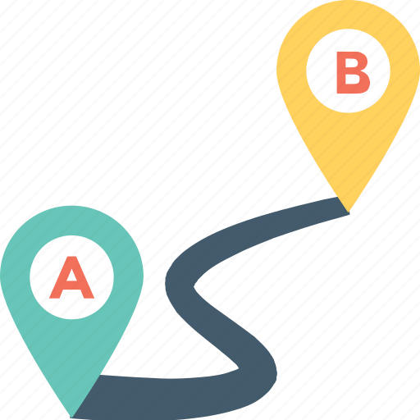
Method IV: best route for a set distance Summary
This method was designed considering people who want to run for a set distance and avoid bad roads
This concept is related to driving where apps will output the best path to avoid traffic. In that situation the traffic would negatively affect the route.
The output of this method is a list of paths that gives a cycle(end at the starting node)
Since it is searching for paths at a specific length, the algorithm stops adding new nodes if it goes over the set distance and backs up and tries a different combination.
Time complexity: if memorization was implemented for calculating the current paths distance it would be O(n+m)

Slide 14
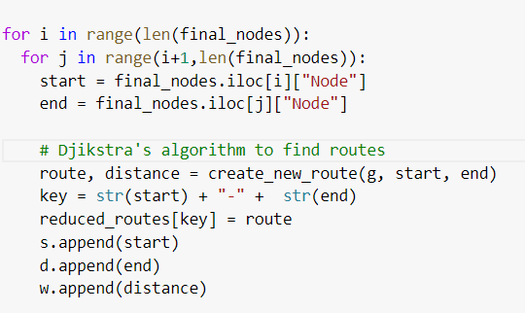
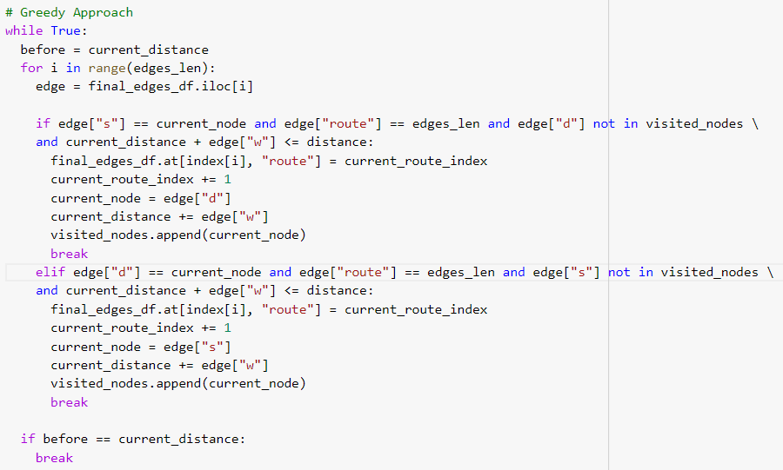
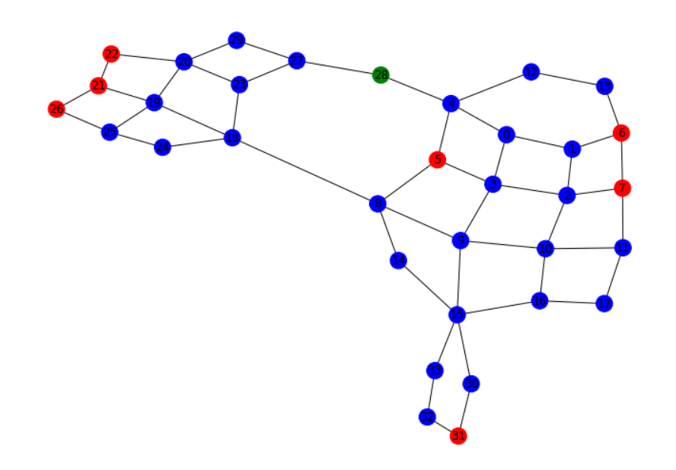
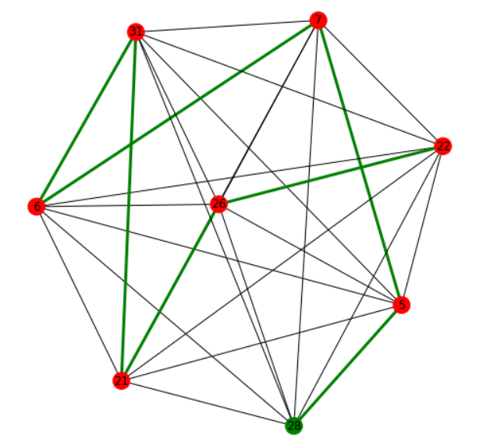
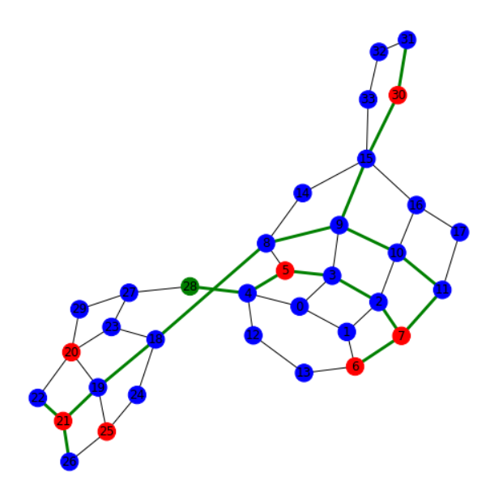
Method V: Visit interesting sites
Algorithm:
Djikstra’s algorithm to find the edges are the shortest path between the interesting sites and the source node allowing the reutilization of edges between different paths.
Create complete graph with paths found.
Use greedy approach to traverse the graph.
Rebuild the paths on the original graph.
Original Graph
Reduced Graph
Reconstructed Graph

Slide 15
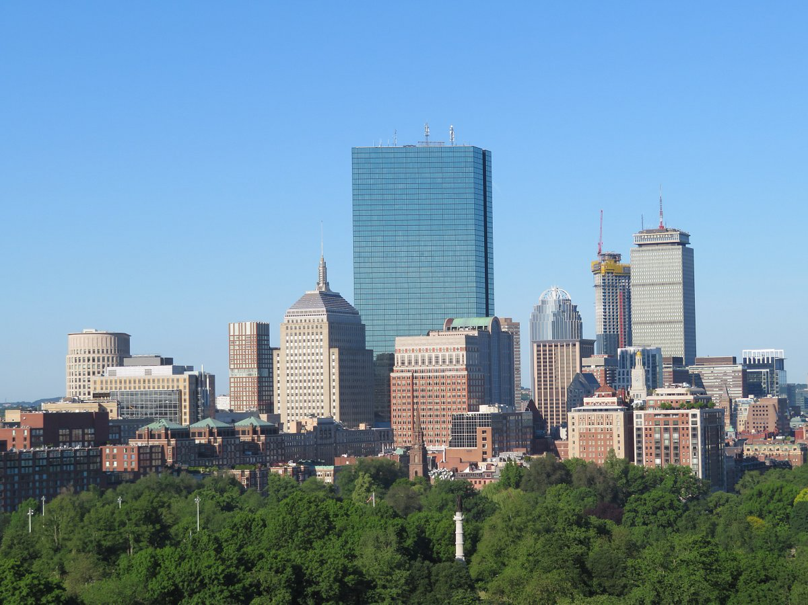
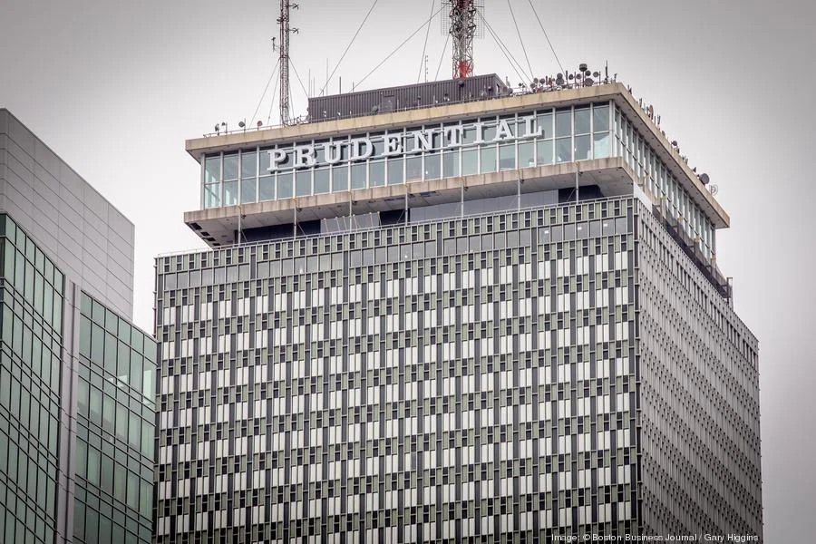
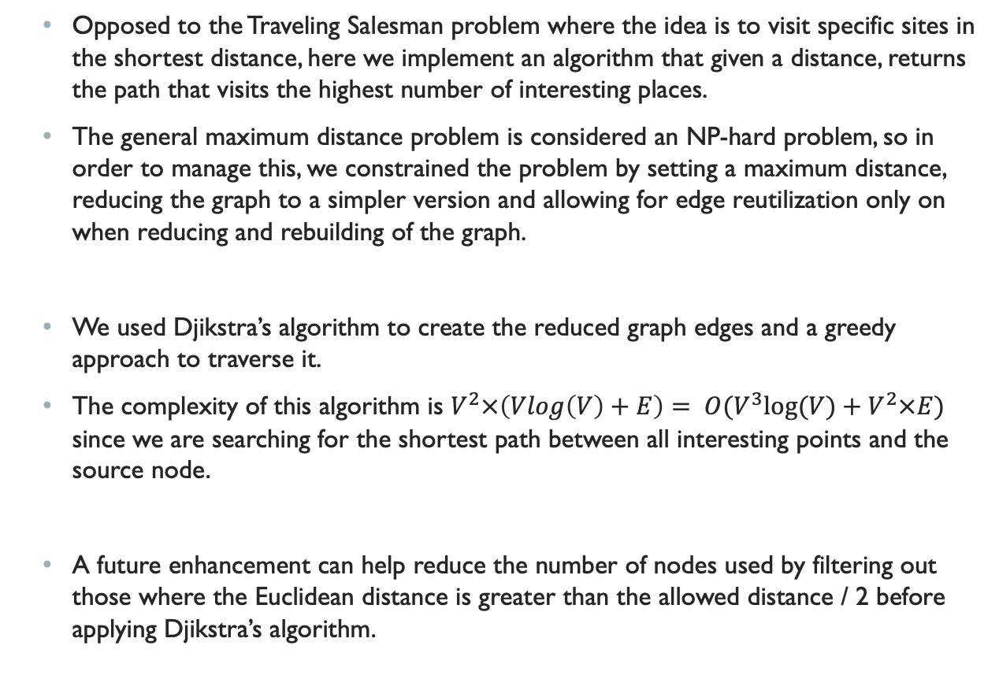
Method V: Visit interesting sites summary
Opposed to the Traveling Salesman problem where the idea is to visit specific sites in the shortest distance, here we implement an algorithm that given a distance, returns the path that visits the highest number of interesting places.
The general maximum distance problem is considered an NP-hard problem, so in order to manage this, we constrained the problem by setting a maximum distance, reducing the graph to a simpler version and allowing for edge reutilization only on when reducing and rebuilding of the graph.
We used Djikstra’s algorithm to create the reduced graph edges and a greedy approach to traverse it.
The complexity of this algorithm is $V^{2}×\left(Vlog\left(V\right)+E\right)= O(V^{3}log⁡(V)+V^{2}×E)$ since we are searching for the shortest path between all interesting points and the source node.
A future enhancement can help reduce the number of nodes used by filtering out those where the Euclidean distance is greater than the allowed distance / 2 before applying Djikstra’s algorithm.

Slide 16
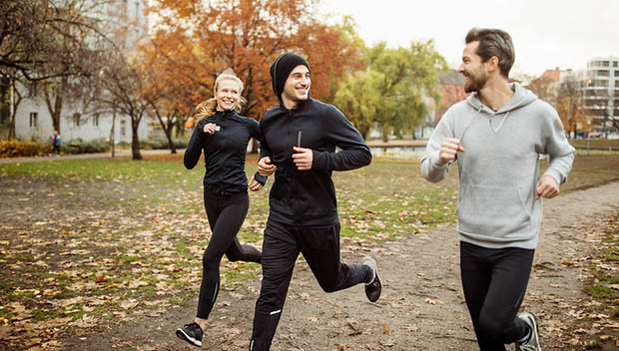
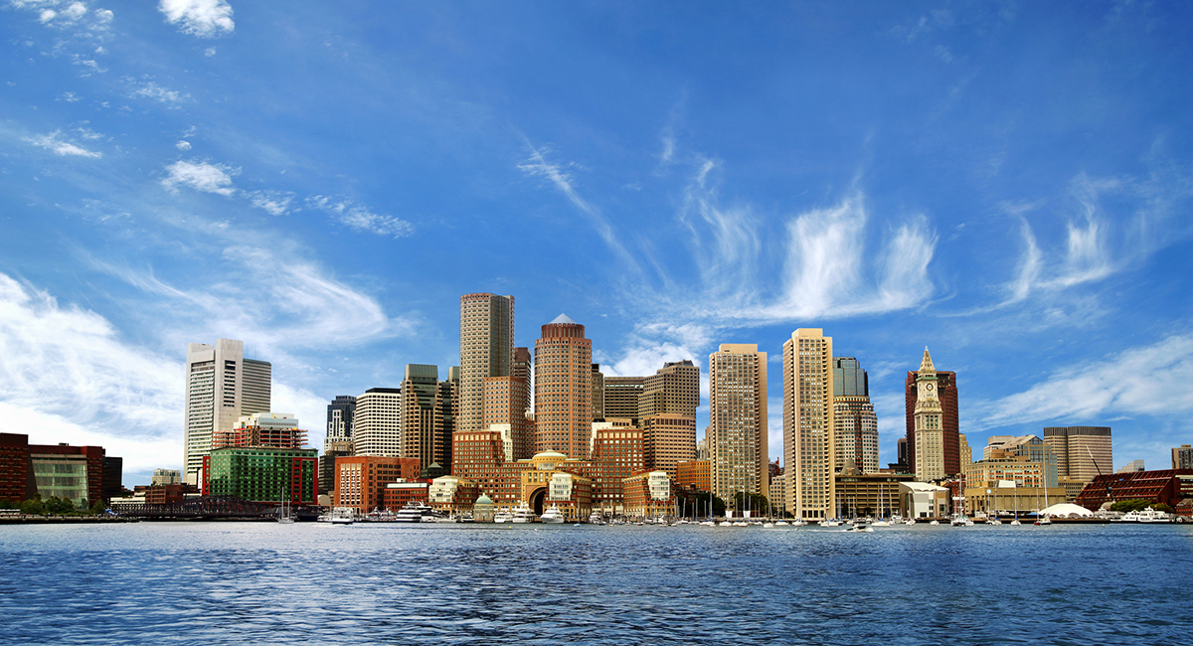
Summary
Within this project we developed and implemented 5 different algorithms and methods that address many runner’s needs to practice for major events such as the Boston Marathon.
We introduced 5 different features represented by 5 different algorithms that help runners find ideal routes in dense cities such as the city of Boston.
The capabilities we successfully introduced and enabled within this POC include:
The ability for long distance runners to find a long path in a small neighborhood and limit the distance based on preference.
The ability for short distance runners to find the shortest path possible to a destination of interest.
The ability to visit interesting sites as specified by the user in the shortest distance possible.
The ability to find routes with the highest quality sidewalks, or least amount of traffic, with the ability to limit the route by a given distance.
The ability to generate an ideal running path to visit interesting sites in the city of Boston to keep runners motivated throughout their run.

